Slide 1

AMAC
Advanced Materials Analysis and Characterization
Master’s Degree Program
Center for Advanced Materials Characterization in ORegon

Slide 2
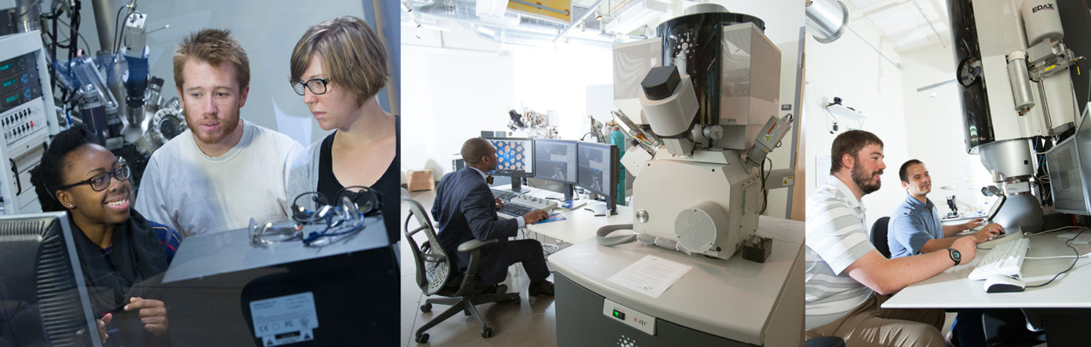
What is AMAC?
Advanced Materials Analysis and Characterization
15-month program culminating in a Master of Science in chemistry
Gain hands-on experience and expertise operating lab tools
Work with industry partners in an internship position to earn a paycheck while you earn a degree!

Slide 3
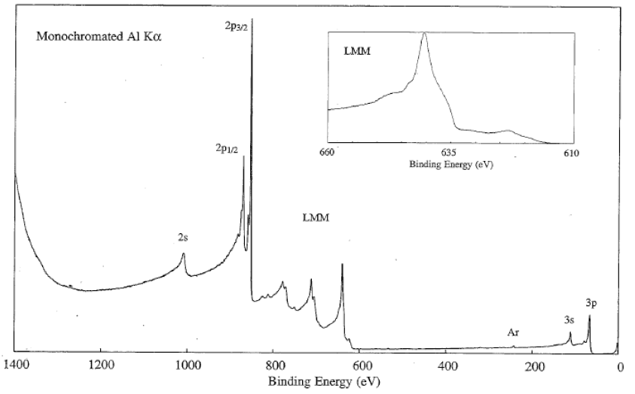
Materials Characterization
What Can You Apply You Skills To?
XPS chemical spectra of Ni
TEM image of atomic columns at a grain boundary
EPMA map of Mg in an
Al-Mg₉₅Gd₅ diffusion couple
FIB cross-sectioned SEM image of a mouse retina

Slide 4
Program Overview
Combination of hands-on classes and internship credits
Starts in Fall term: Fall and Winter terms spent on campus and after that students are on location at internship site
Capstone project required
54 total credits required: 28 graded & 26 research internship credits
3.0 GPA required to graduate program
$540/credit, or ~$6480 for Fall Term and ~$8640 for Winter Term (~$600 in additional university fees may also be applied)
Paid internships help offset initial program cost to you – M.S. has a $13,000-$28,000 increase in annual earning protentional over a B.S.

Slide 5
Program Overview
Capstone Project
Group project investigating a real materials characterization problem
Analyze materials using multiple techniques learned
Present your findings at the end of Winter Term

Slide 6
Program Overview
Course Schedule
Fall Term:
  Electron Microscopy Fundamentals
  4 credits
  Introduction to Surface Analysis
  4 credits
  Electron Probe Microanalysis
  4 credits
  Nuclear Magnetic Resonance
  4 credits - optional elective
Winter Term:
  Electronics and Vacuum Systems
  4 credits
  Advanced Electron Microscopy
  4 credits
  Advanced TEM Analysis
  4 credits
  Advanced Techniques in Surface Analysis
  4 credits
Spring-Fall Terms:
  Research Internship
  8-10 credits/quarter

Slide 7
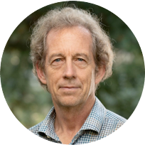




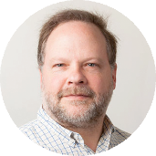
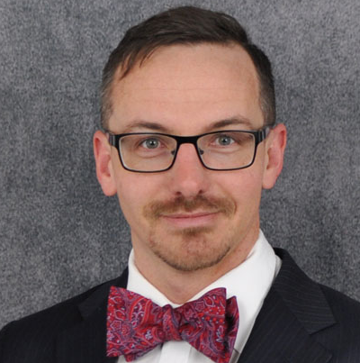
Coursework Overview
Complete classes with analytical experts
Surface Sciences
Electron Microprobe
Transmission Electron Microscope
Focused Ion Beam
Scanning Electron Microscope
Electronics and Vacuum Science
Nuclear Magnetic Resonance

Slide 8
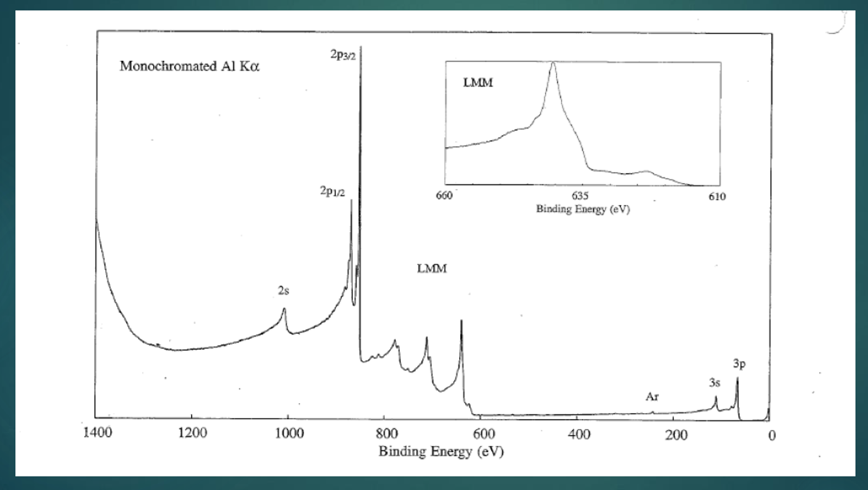

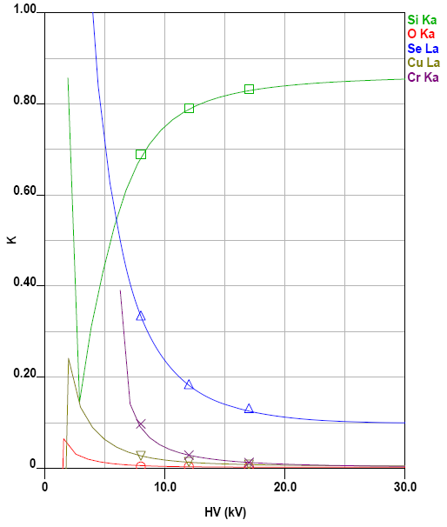
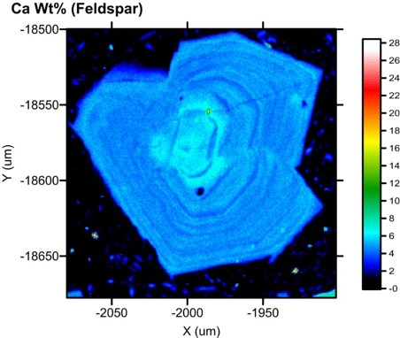
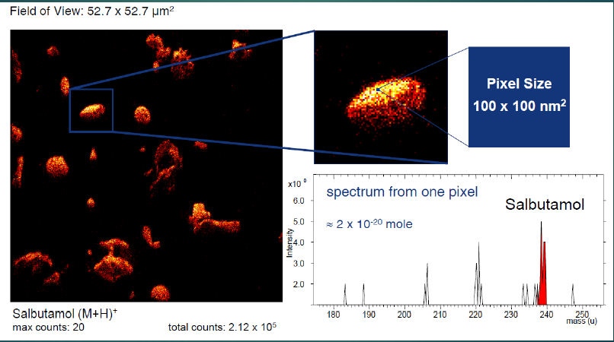
Chemical Analysis Techniques
Surface Analysis and Electron Microprobe
Quartz (SiO₂)
Rutile (TiO₂)
Watkins, UO
50µm
Trace Ti profile in quartz
Cr, Cu, Se, & O Film
Si Substrate
Feldspar grain growth pattern illuminated with Ca composition map
Esters, DukeUO
Thin film composition measurements & modeling
Notes:
EPMA:
-Ti in quartz important thermobarometer in geology
-Ca/other elements can show how a mineral has formed and/or been impacted by heat/pressure events
-accurate thin film compositions can be determined by measuring samples at 3 voltages and then using modeling software to back out the composition of the film vs substrate

Slide 9
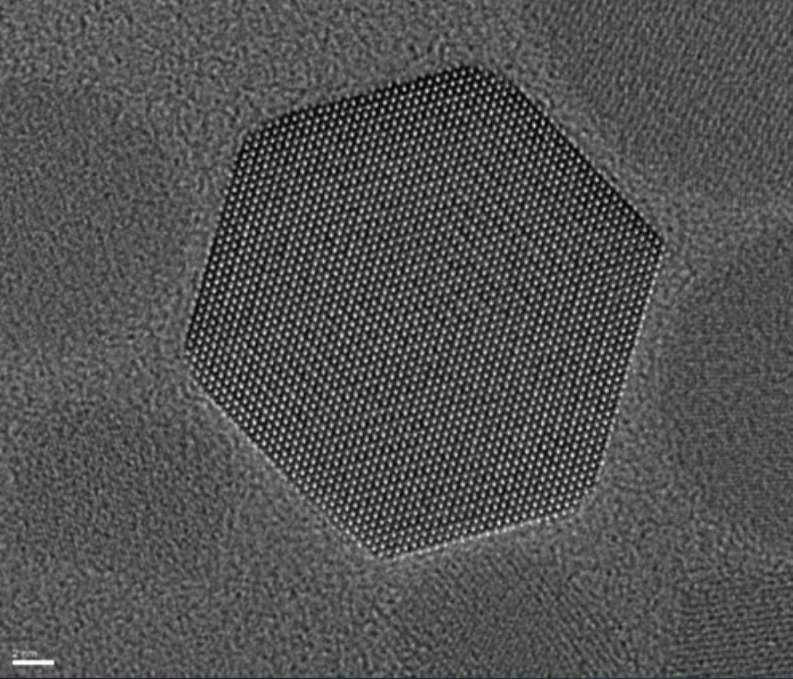
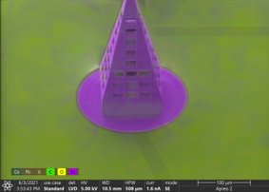
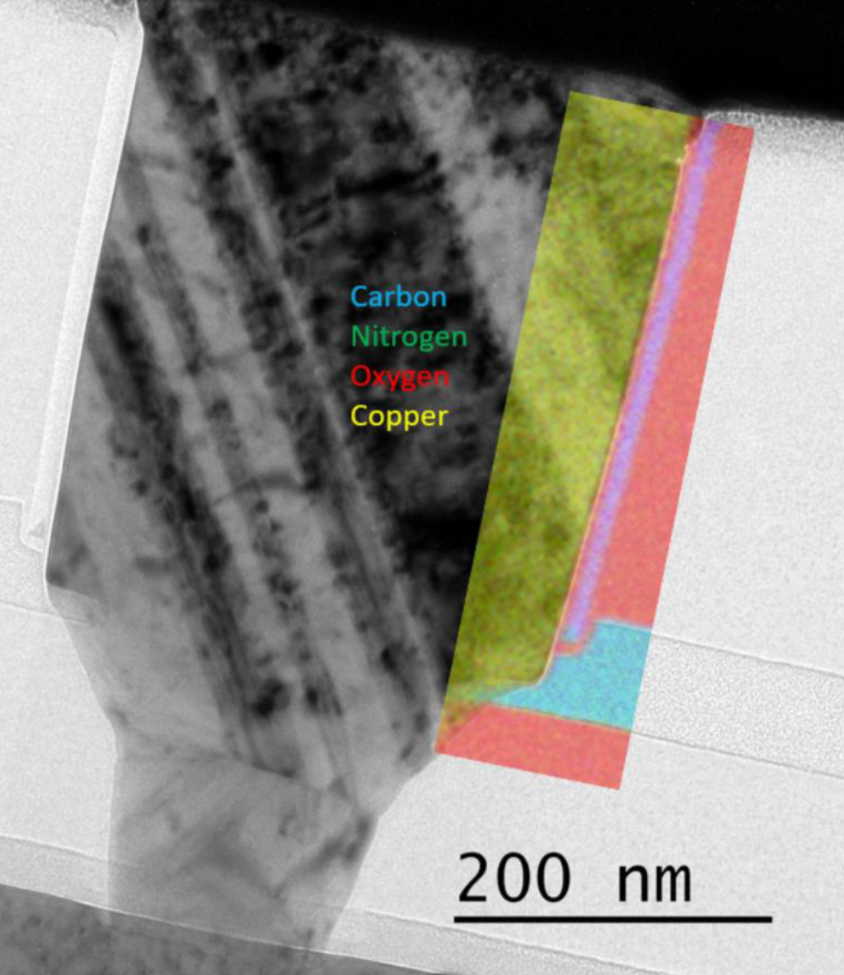
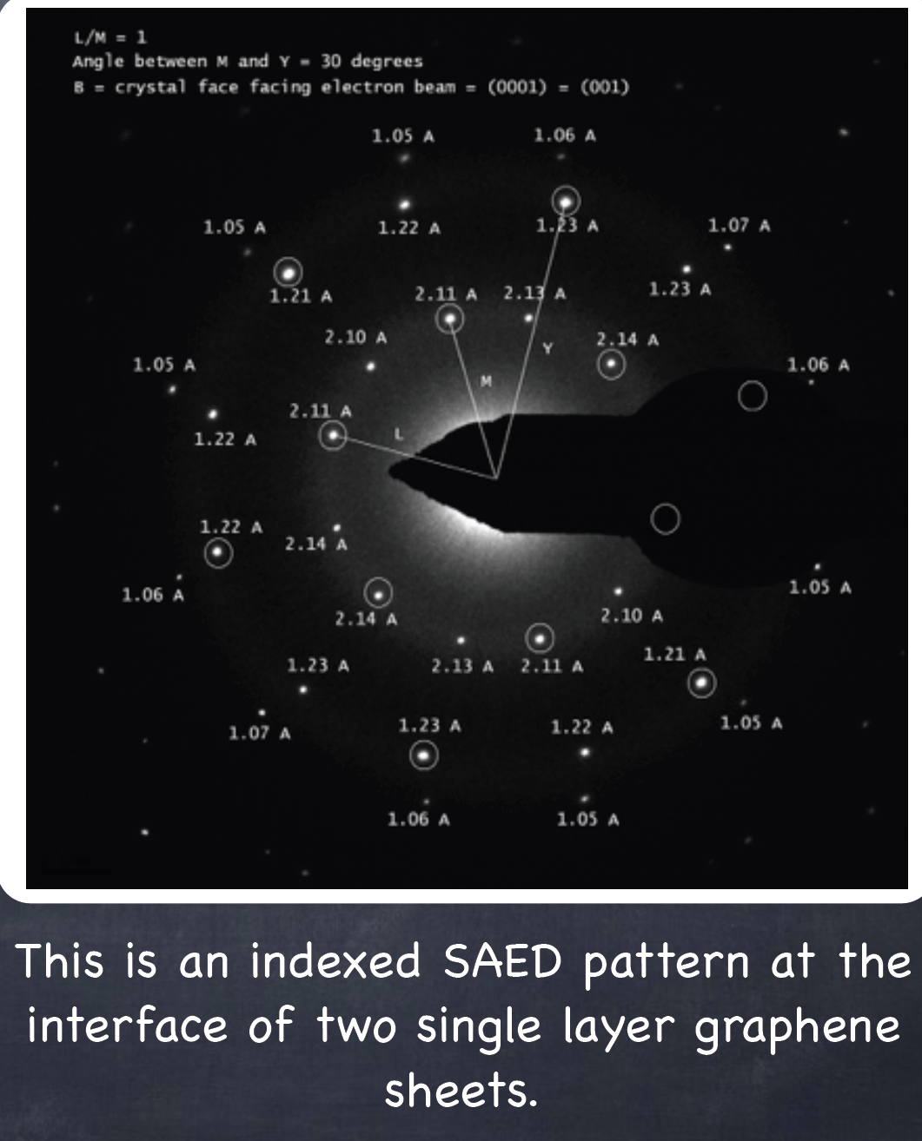
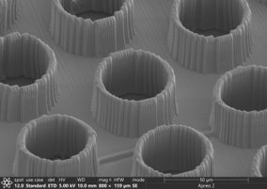
High Resolution Analysis
Transmission Electron and Scanning Electron Microscopes

Slide 10
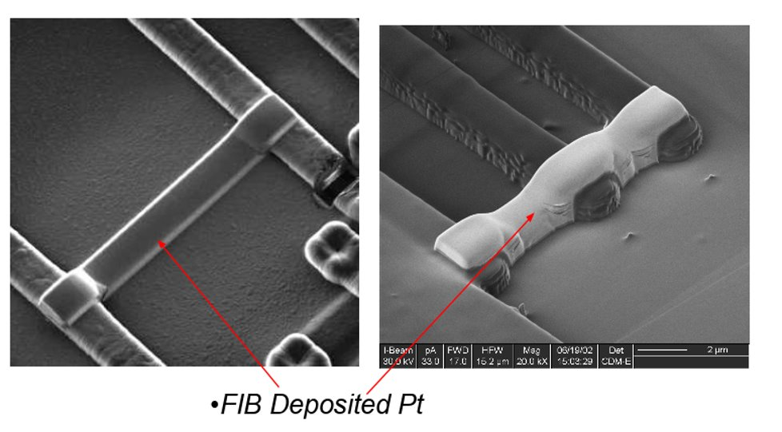
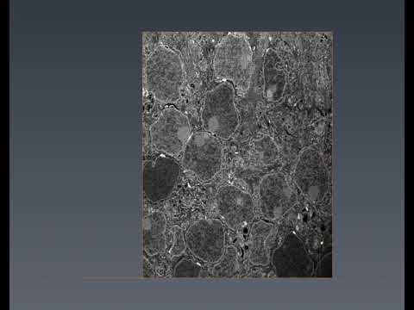
Focused Ion Beam
Depositing Metals, Nanoprototyping
Dual Beam FIB/SEM
Cross-Sectioning
FIB deposited Pt
Looking top-down with the FIB-SEM
Looking into the cross-section after cutting with FIB
3D Reconstructions

Slide 11
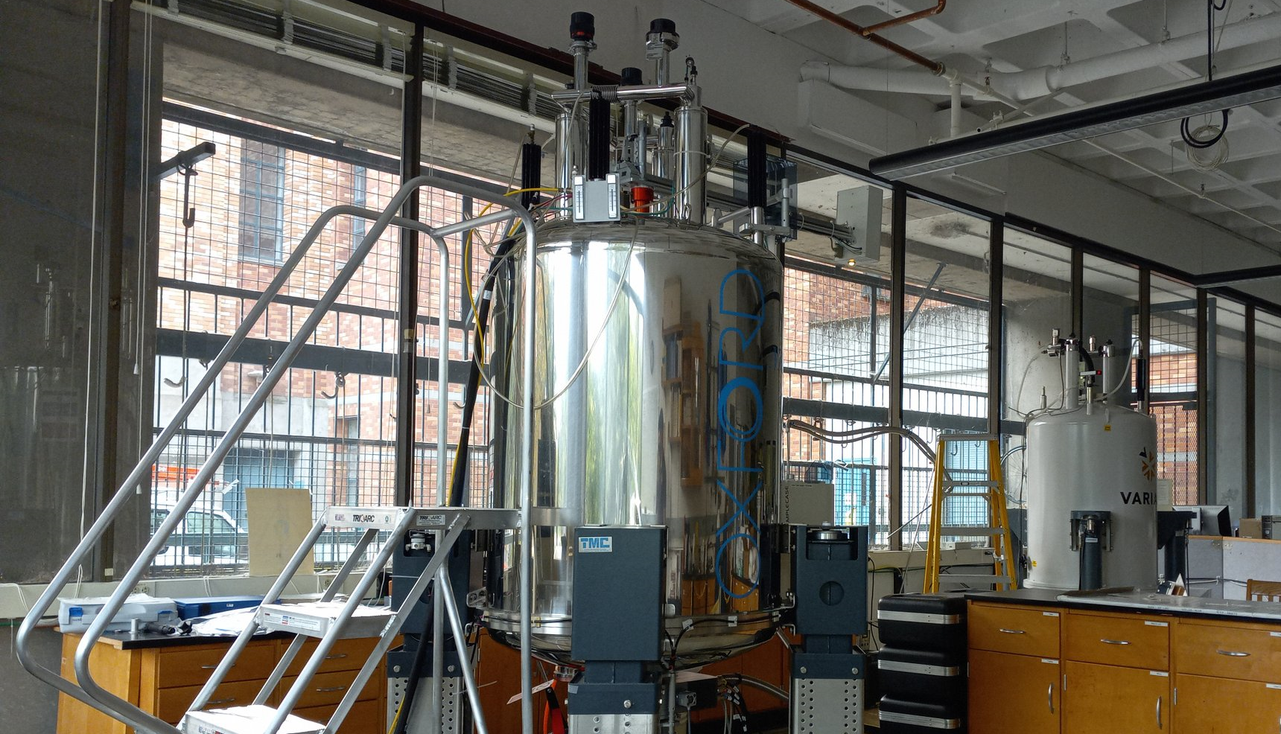
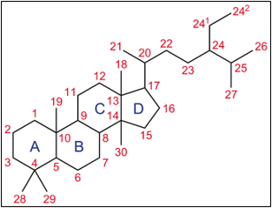
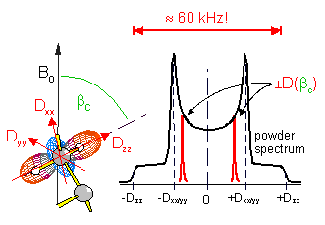
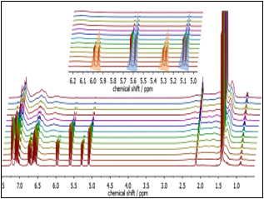
Nuclear Magnetic Resonance
NMR
• Structure Analysis
• Solids/Liquid Dynamics
• 4 Super Conducting Magnets
• Specialized High Sensitivity Probes
• Solids and Liquids Dedicated Instruments
• -196° C to 80° C Capabilities
• Large Nuclei Range
• Chemical Kinetics

Slide 12
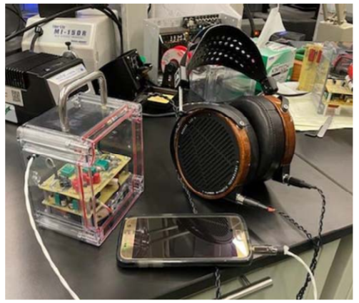
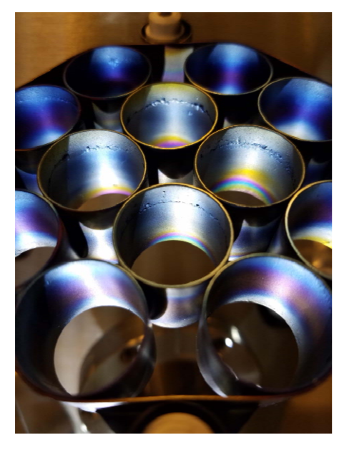
Electronics and Vacuum Science
Electrical components, circuits, and vacuum systems
• Roughing Pumps
• Vacuum Measurement
• Turbo Pumps, Ion Pumps and their controllers
• Conductance & Differential Pumping
• Understand schematic diagrams
• Use LED’s, DVM’s, Oscilloscopes, RC and RL circuits (time constants) Capacitors, Inductors, and Transformers and more.
• Surface Mount Soldering
• Build your own headphone amp!

Slide 13
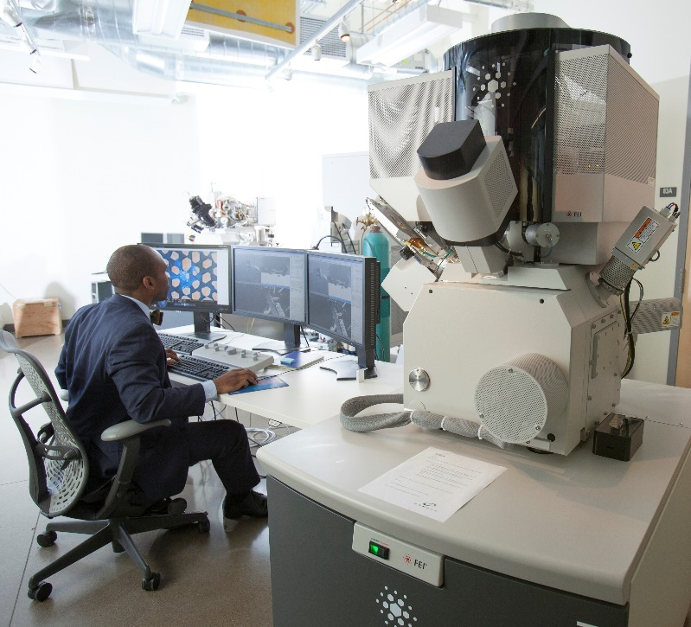
CAMCOR Facility
Cutting-Edge Facilities and Equipment
Over $35M of capital equipment in an open-access environment
Ultra-stable lab environment that exceeds NIST A standards for vibration, EMI, and temperature control
Industrial and academic clients from all technology sectors.
Hundreds of clients from every industry across the world.

Slide 14
Facility Highlights
Only open-access facility in the world with some of these tools!
Equipment and expertise to characterize nearly any phase of material from liquid, to solid-state.
Continual reinvestment in cutting-edge equipment to grow scientific impact of facility.
In-house custom machine & electronics shop for novel sample prep, & custom parts for equipment.
On-site service engineer for greater than 95% tool uptime across facility.
We have a large and varied tool set, all in one location

Slide 15

Welcome to Eugene!
Nestled between rivers, mountains, and a rocky coastline
Just an hour away from the coast and mountains
Outdoor recreation mecca: hiking, biking, skiing, rock climbing and more!
Home of the Oregon Ducks, TrackTown USA, and Eugene Emeralds
Abundant restaurants, bars, breweries, and wineries
Art and culture: Hult Center, JSMA, MNCH, and Saturday Market

Slide 16


AMAC Alumni
In Academia
Kerisha Williams
  PhD Student in Materials Science and Engineering at Georgia Tech
“One of the best things about AMAC is that I have the background knowledge in so many platforms that I don't feel trapped in what I am doing now.”
Eric Hammerschmith
Research Specialist, Princeton University
“The Advanced Materials Analysis and Characterization program gave me the knowledge to be able to further pursue my research interests using advanced electron-based imaging and analysis to answer major biological questions.”

Slide 17
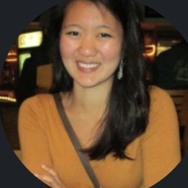
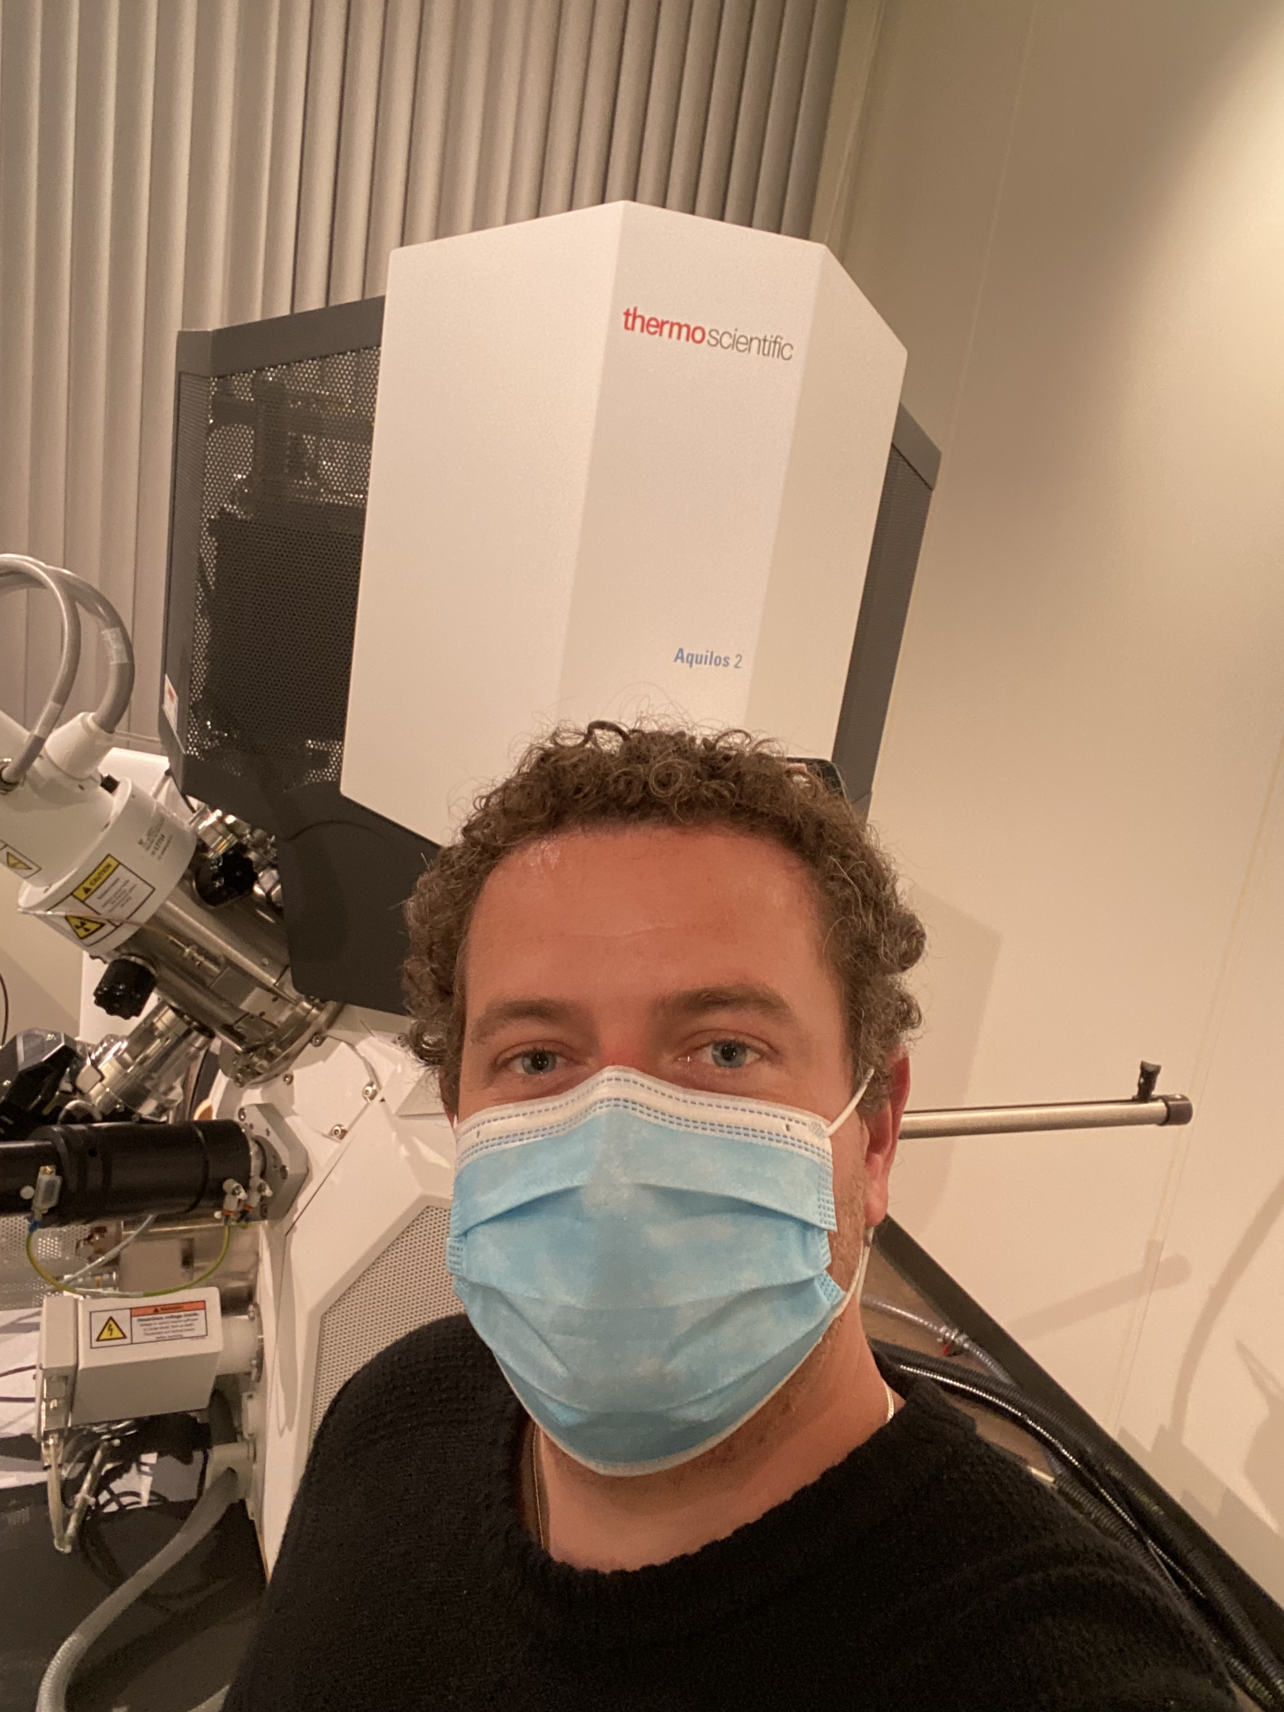
AMAC Alumni
In Industry
Jessica Chau
Process Systems Engineer, Facebook Reality Labs
“… my team is now building the first display prototypes for future AR products… The hands-on experience I gained through the program equipped me with the ability to quickly add value to the research team…”
Chris Thompson
Field Applications Scientist, Thermo Fisher
“It is without a doubt that the AMAC program provided me with the knowledge, experience, and credentials to be successful in my current position.”

Slide 18

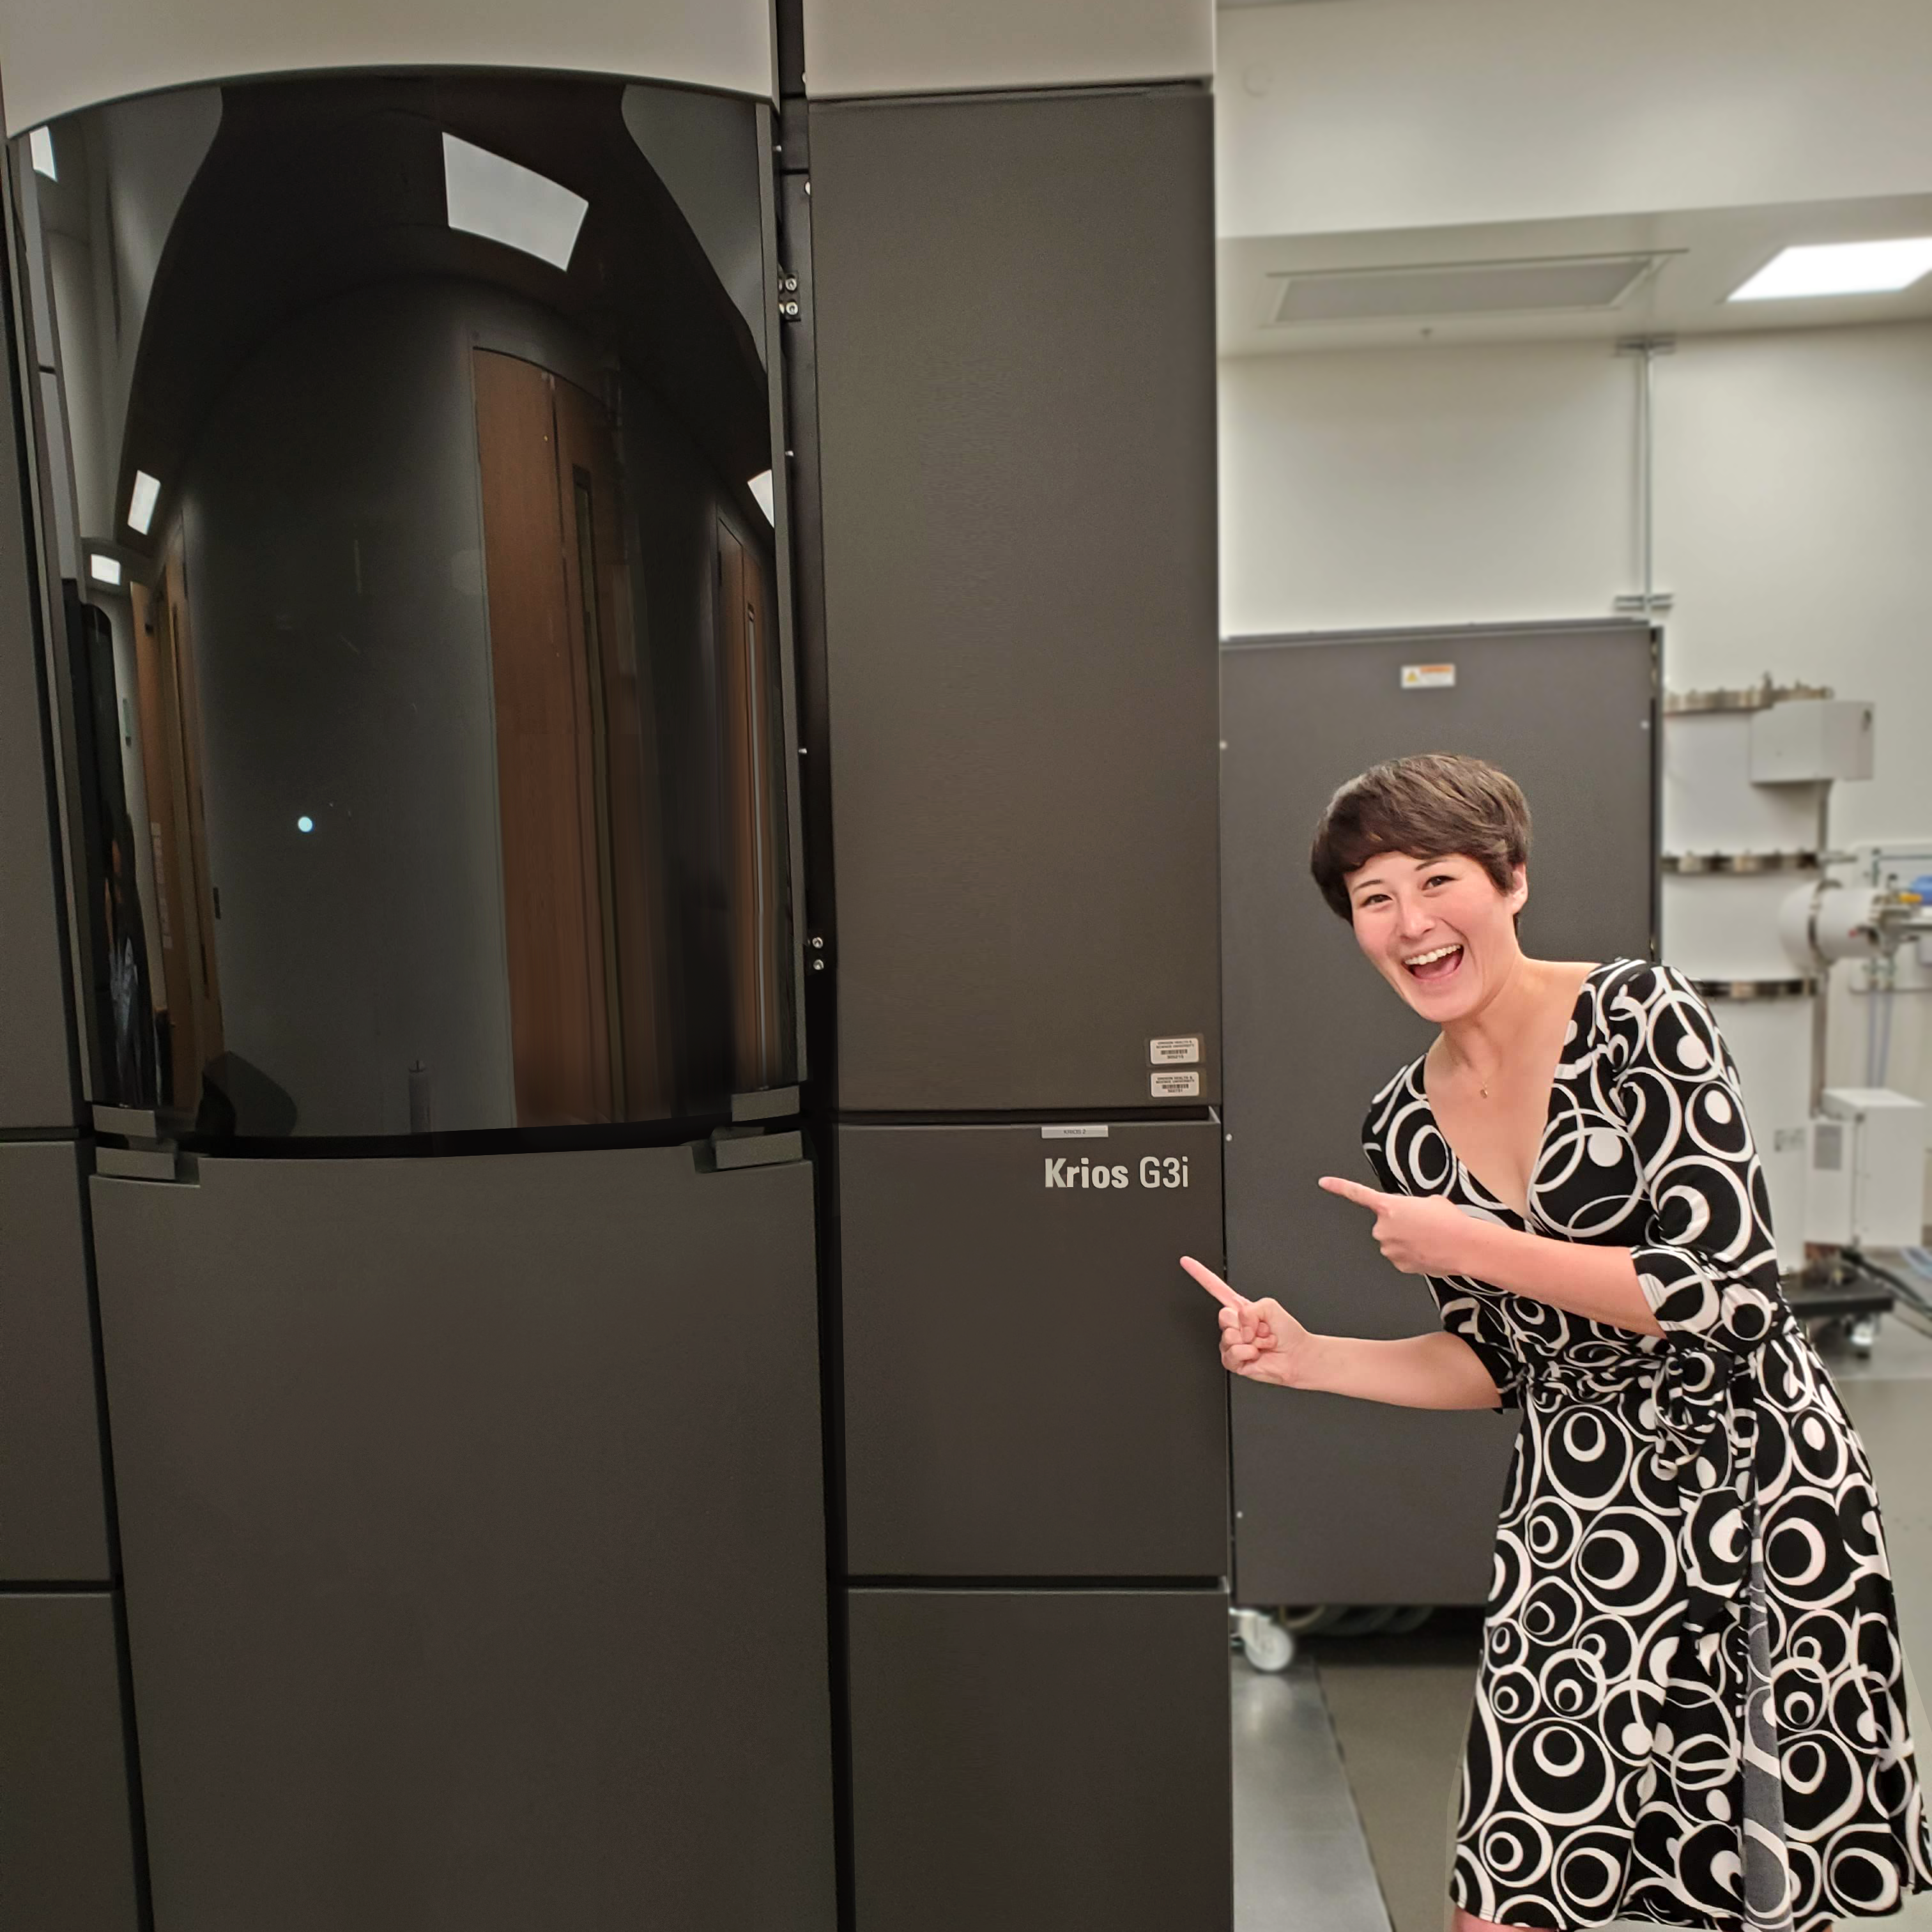
AMAC Alumni
In Industry
Jada Ward
Materials Engineer, Panasonic
“Every day, I work with highly advanced and innovative tools… [the] AMAC program helped to prepare me for this career path by expanding my knowledge in electron microscopy, x-ray spectroscopy, ion mass spectrometry, electron microprobe analysis, and so much more!”
Aleia Kim
Technical Marketing at Covalent Metrology
“AMAC gave me the problem-solving frameworks and thinking tools needed to adapt to analyzing samples in everything from space shuttles down to microprocessors”

Slide 19
AMAC Master’s Degree Program
Apply Online
https://camcor.uoregon.edu/advanced-materials-analysis-and-characterization-masters-degree/

